Slide 1
School mapping in ESRI imagery
Andrija Gorup, Dominik Jambrović, Marin Kačan, Siniša Šegvić
January 16th, 2025

Slide 2
Recap from last meeting

Slide 3
Model fine-tuning
All Anditi schools + equal number of OSM Vietnam non-schools
Static Gaussian non-school sampling
20 epochs
Train results
F1: 99.55%
P: 99.80%
R: 99.30%

Slide 4
Dense inference
Use fine-tuned model on overlapping satellite images (tiles) from chosen districts
Perform non-maximum suppression (NMS) to reduce the number of duplicate detections
Measure number of detected Anditi schools (train data)
Deliver list of potential schools sorted by prediction confidence

Slide 5
Dense inference results (after NMS)
Check performance on train data (Anditi schools) – sanity check before evaluation
Found 900/946 (95.14%) Anditi schools
Recall: 95.14%
46 not detected schools (4.86%)
List of potential schools: 9573 images

Slide 6
Problems
No dataset for evaluating the final fine-tuned model
Only measured train recall, not precision and F1 score

Slide 7
New contributions

Slide 8
New validation datasets
We have hand-collected two subsets of school locations:
Exhaustive dataset
Wide dataset
Can be used for evaluating the final fine-tuned model

Slide 9
Exhaustive (narrow) dataset
Locations from 4 subdistricts (wards) from Thủ Đức District:
Linh Xuan Ward
Binh Chieu Ward
Tam Binh Ward
Hiep Binh Phuoc Ward
110 schools (exhaustive search), 1163 overlapping tiles total (after filtering)
Can be used for calculating precision, recall and F1 score

Slide 10
Wide dataset
Locations from 5 districts:
Lê Chân District
Hoài Đức District
Cà Mau
Bà Rịa
Sóc Trăng
93 schools (not exhaustive search!), 20 981 overlapping tiles total (after filtering)
Can be used for calculating recall

Slide 11
Threshold validation
We want to determine the ideal classification threshold
Get dense inference predictions for exhaustive dataset
Measure F1 score on predictions for variable thresholds (0-1)
Pick threshold with the highest F1 score
Get recall, precision and F1 score for chosen threshold on exhaustive dataset

Slide 12
Threshold validation
Procedure is applied to multiple models with different fine-tune configurations (fine-tune on Anditi dataset with non-schools sampled from OSM Vietnam)
Different number of fine-tune epochs:
1 epoch
20 epochs
Dynamic Gaussian non-school sampling with different school : non-school sampling ratios:
1:1
1:10

Slide 13
Threshold validation, results
School : non-school ratio | Fine-tune epochs | Best threshold (%) | Best F1 score (%) | Best Recall (%) | Best precision (%)
1:1 | 20 | 3.61 | 61.85 | 97.27 | 45.34
1:10 | 20 | 4.04 | 63.70 | 84.55 | 51.10
1:1 | 1 | 8.35 | 70.90 | 96.36 | 56.08
1:10 | 1 | 6.33 | 69.14 | 76.36 | 63.16

Slide 14
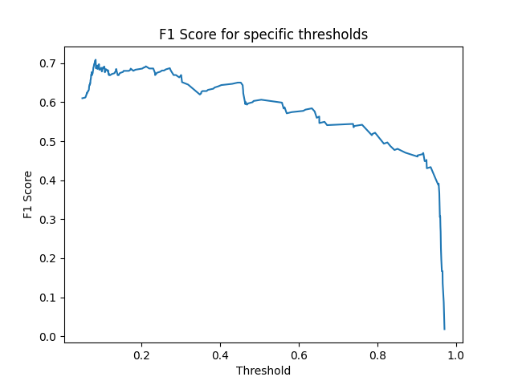
Threshold validation, 1:1 ratio, 1 epoch

Slide 15
Conclusion & Future work
F1 score for fine-tuned model (1:1 ratio, 1 epoch):
Train: 92.55%
Exhaustive: 70.90%
Fine-tuning for 20 epochs may overfit the nation-wide model to Anditi dataset
Explore and test options for reducing overfitting

